Slide 1


6th annual health insurance conference
2020

Slide 2

the world is changing
Notes:
We have to accept the fact that the world is changing fast and we as humans as well as industry should cope, adapt and benefit
Technology is evolving so fast that we see old generations embracing the latest technologies

Slide 3

The new normal
Notes:
Also people are living long enough to witness the revolution in our technological world
Life Expectancy almost doubled over the last 200 years
UK: In 1841, a baby girl was expected to live to just 42 years of age, a boy to 40. In 2016, a baby girl could expect to reach 83; a boy, 79
Most importantly, we’re aging well (it was easy in the past to guess someone’s age, well not anymore, especially for ladies ☺

Slide 4

Rising HEALTHCARE Costs: challenge or opportunity
Notes:
We have to accept the fact that the world is changing fast and we as humans as well as industry should cope, adapt and benefit
Technology is evolving so fast that we see old generations embracing the latest technologies

Slide 5
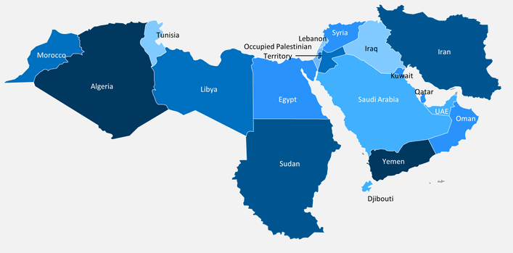
Healthcare Expenditure
MENA: Fastest Growing
Global healthcare expenditure
(in current USD Tn)
Healthcare expenditure
per capita growth (2010-2016)
6.7%
Notes:
But before going into details, thought of recalling some data related to the sector
Data may vary depending on sources, however the MEA region is always ranking amongst the highest growth region
OPPORTUNITY, not a CHALLENGE as allowing more rooms for investments and innovation.
However, cost-effective solutions are paramount to maintain sustainability whilst offering the quality services.
What could be cost effective solutions?
I will try to tap into one of the many enablers: DIGITAL and INNOVATION

Slide 6




contributors to the rising need
for healthcare
DISEASE BURDEN
COST TO TREAT
AGEING
LIFESTYLE RELATED RISK FACTORS
ACCESS
INNOVATION
More elderly living longer while cost per life doubles every 20 years of age
Diet
Sedentary
Lifestyles
Pollution…
Access to quality care for a large emerging middle class
Personalized medicine
Biologic drugs
Notes:
Challenges:
Aging Population: With an aging population come higher healthcare costs
Lifestyle Related Risk Factors: Diet, sedentary lifestyles, increasing share of chronic illnesses
Climate Changes: Prevalence of non-endemic diseases (warmer temperature favouring insects born diseases, epidemics, etc.)
Exponential advances in innovation/Costly Solutions: Addressed through M&A, Investments thus cost impact, alternative revenues sources, Digitalisation, etc.
Enablers:
Access to care: Access to care for a large emerging middle class
Preventative Care: Adoption of efficient/quality based approaches – Precision Medicine / Early Intervention
Innovation: Digital technologies, Healthcare personalization

Slide 7
“Digital first” – Insurance vs. Healthcare where do we Stand?
Logistics
Impact of digital
and analytics
Media
Media
Retail
Retail
Insurance and banking
Automotive
Automotive
Logistics
Energy
Health care
Health care
Energy
Insurance and banking
Point on digitization journey
Source: BCG analysis
Notes:
How digital is our industry?
Media: How many of us still reads the newspaper? Buying Music CDs? Streaming music and movies?
Banking: Who is doing online banking? Who is banking with a pure online bank?
Auto: xx numbers from Matthias?
Health care: Who has an up to date electronic medical record? who did a teleconsultation last year? Who already booked an appt online?
This is to underline that there is more room to grow and this is where we as TPA can help through innovation and digital: mHealth, e-processes, telemedicine, self servicing digital tools, AI…

Slide 8

Digital journey: Evolution
Member Registration
Self-Service
Electronic Payment
Eligibility Check
Enhanced
E-Payment
Tele-Health
INTEGRATION WITH REGULATORY BODIES
Drug Prescription
Dispensing
Pre-Certification
AI/ML Enabled Adjudication
AI/ML Enabled Edits/Automation
Claim Adjudication
Medical Service
E-Invoice
Notes:
As a TPA, NEXtCARE mapped the typical journey of an insured member availing treatment, and though it is a straight forward model, there are several areas of improvements:
Imagine for a moment a typical digital journey… imagine for a moment…
A Self-service tools: Symptom Checker → Suggestion to conduct a teleconsultation → Recommendation to see a practitioner → Appointment Booking → Consultation → Drug Delivery → Personalised Follow Up
well, we don’t need to imagine… patients are already expecting this to happen, and not in 2040… but NOW
What about sustainability: AI/ML edits and adjudication allowing much better outcome at a faster TAT?
Provider/Payer agreed mechanism whereby approved conditions get automatically paid from patient “e-Health Wallet” → better negotiated prices?

Slide 9

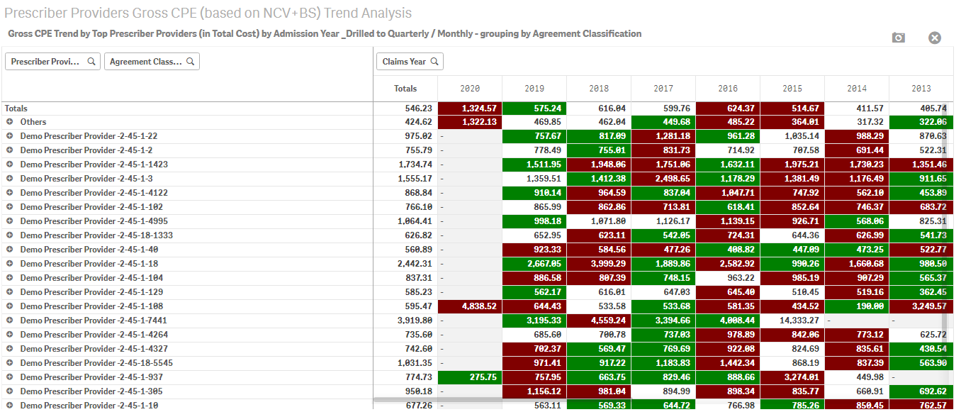
PREDICTION & PREVENTION
Trends
Data Mining
Predictive Analysis
Using various metrics
Prevention

Slide 10
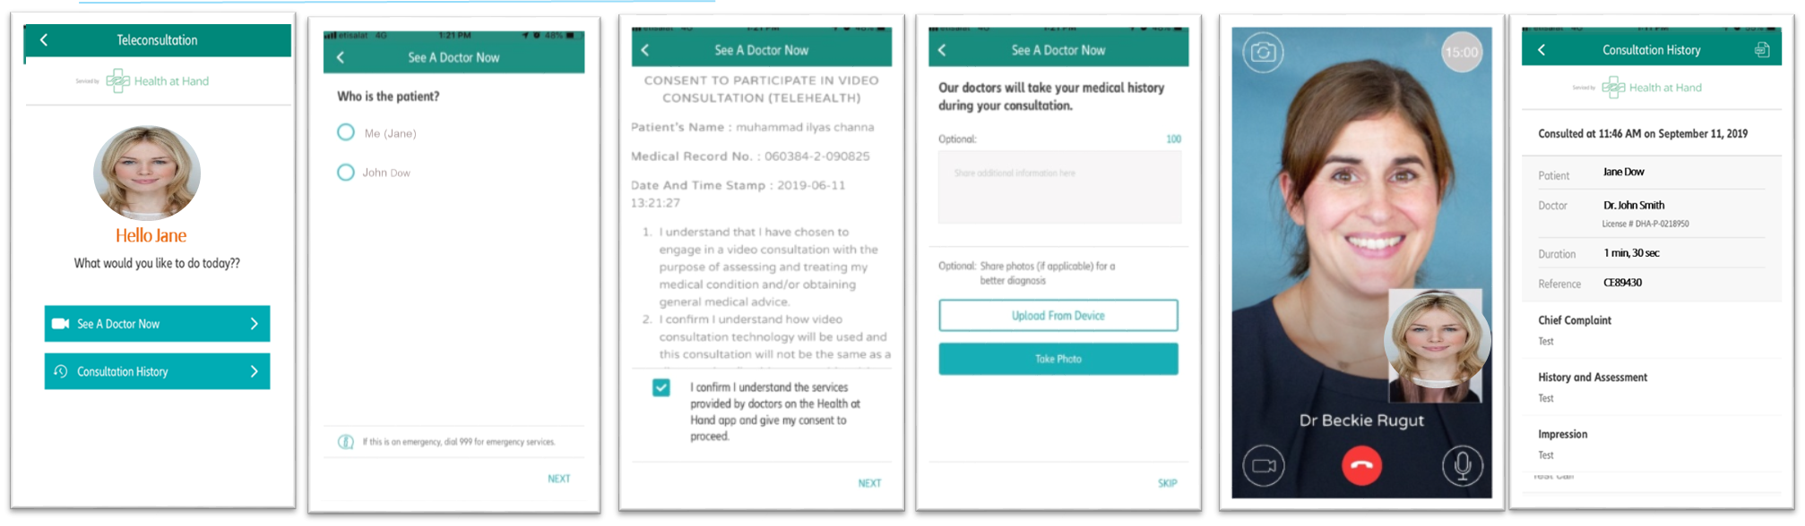

Teleconsultation – THE JOURNEY
Home
Select Patient
Consent
Medical Questions
Call
Doctor’s Report
Receive medical report with doctor’s advice and prescription, post call
Give consent
Fill out medical questions
Begin Video consultation
Click on “See a doctor now” icon
Select the beneficiary

Slide 11
Telehealth can address key pain points
Pain Point
High Costs
Appointment availability
Restrictive Opening Hours
Distance to Doctor
Complexity
Solution
Lower Cost
Avoid a physical consultation
24 / 7 Access
Immediate access at any time a medical specialist
Convenience
Enable patients to see a doctor when they need one
Time Saving
Save time spent travelling to, and waiting at the clinic
Simplicity
Provide digital, on-demand, seamless experiences
Notes:
63% Currently spend over 45 minutes in travel and wait time for each doctor’s visit
69% Will delay seeing the doctor either because they are too busy or they think the problem will go away
70% willing / happy to use a teleconsultation service

Slide 12



Teleconsultation – FIRST RESULTS
1 year pilot with Teleconsultation service on premium policies showed:
Utilization rate has been increasing regularly as more communication on the service was made to reach now 1.9% on annualized basis
89% of all cases managed through Video-consultation were resolved, with no subsequent visit in the network
  55% of calls required prescriptions
Teleconsultation has proven during the pilot to enable cost savings
Patient satisfaction is high with:
Average doctor rating: 4.9
Average call rating: 4.8
Top 10 pathologies diagnosed
Acute upper respiratory infection, unspecified
Acute nasopharyngitis [common cold]
Acute gastroenteritis
Dehydration
Low back pain
Rash and other nonspecific skin eruption
Acute pharyngitis, unspecified
Metatarsalgia, unspecified foot
Unspecified abdominal pain
Eczematous dermatitis of right eye, unspecified eyelid
Click on “See a doctor now” icon

Slide 13
imperative to move to Value-based healthcare
Past & Present
Future
Payers
“Cut unit cost”
Payers
“Reward efficient outcomes”
Value =
Volume
Outcomes
Cost
Providers
“Capitalise on volumes”
Providers
"Maintain profit by innovating"
Notes:
value-based payment models that help providers, payers, and patients achieve the best outcomes at the lowest cost.

Slide 14





THE WAY FORWARD
STAKEHOLDERS
COLLABORATION
PREVENTATIVE
CARE
VALUE-BASED HC
E HEALTH
AGENDA
DIGITAL
TRANSFORMATION
Notes:
Where do we go from here: this is to emphasize what all stakeholders need to do to be able to sustain on a long term a proper E Health strategy
There should be a favourable ecosystem to foster and put the change in motion:
STAKEHOLDERS: It’s not enough for only some parties to be involved in the process. Government, Regulators, Medical providers, Insurance Companies need to be part of it.
E HEALTH AGENDA: E Health Agenda must include appropriate technical infrastructure and technical interfaces for all stakeholders, e processes to ease the journey and manage costs i.e. e-claims, e-prescription, e-billing, digital tools to empower people to look after their health, patient-centric record for all clinical information which is available to all health and social care professionals and patients
PREVENTATIVE CARE: Empowering people to take actions to be able to prevent health events before they occur i.e. genetic screening, well being programs, regular check ups, disease screening, embrace healthy lifestyles
DIGITAL TRANSFORMATION: Digital transformation it is a mind set to be able to drive the vision of an integrated E Health Ecosystem
HEALTH KNOWLEDGE MANAGEMENT : Health Knowledge Management includes international medical guidelines, good medical practices, healthcare professionals sharing health information through digital equipment
eHealth can address several ones of these challenges. Capitalise on technologies and new services is a must for a sustainable model whilst addressing quality and cost as well as broadening the access base to healthcare.
“eHealth offers solutions to these challenges. It means getting the most out of technologies and new services. It allows us to improve the quality of treatment and broaden access to medical care. It can help to reduce pressures on public healthcare budgets – in both the industrialised and developing world”

Slide 15


thank YOU

